Slide 1
Digital Signatures Decoded Crafting an In-House E-Signing Microservice
Amol Gote
Innova Solutions – Consultant,
Solutions Architect at iCreditWorks
Notes:
Slide 1, Time – 2 Minutes
My Name is Amol Gote and today I will be presenting on the topic related to digital signing of the documents
Digitally signing documents is very common task these days and I am pretty sure you guys must have done it as well. This capability has been there for quite some time now, then what is so special or unique about this presentation.
If we have to digitally sign document there are so many third-party solutions, one vendor been the pioneer in this space.
Vendors that are in Digital document signing space
DocuSign
Adobe Sign
SignNow
HelloSign
Dropbox Sign
In this presentation we will delve in how we can build equivalent capability using open-source frameworks and tools and take control of the user experience in your customer interaction.

Slide 2
Agenda
Introduction
Demo, Key Takeaways.
Regulatory Standards
Case study - iCreditWorks
Building an in-house e-signing microservice
Security Measures
Open-source availability
Notes:
Slide 2, Time 2 Minutes
We will start first with introduction about my self
Today, we will not only talk about these concepts but also see them in action. We'll start with a live demo showcasing the actual process of signing a document using our in-house solution. This will give you a clear view of the user experience and the seamless integration of our service into daily workflows.
We'll also navigate the complex landscape of regulatory standards and compliance measures.
Our journey includes a case study from iCreditWorks. We'll discuss the 'why' behind our decision to develop our own service, delving into the challenges we faced and the strategic benefits we've reaped.
A significant portion of our time will be spent unraveling the technical details. We'll dissect the technology stack and open-source frameworks and tools that power our solution. We'll also provide an in-depth walkthrough of our APIs, demonstrating the robustness and flexibility of the two-step signing process.
As we reach the culmination of our presentation, we'll discuss the crucial aspect of protecting signed documents. Security doesn't stop at the signature line; it extends to the entire lifecycle of the document.
And finally, we'll address the open-source availability of our solution, which is the cornerstone of today's discussion. The decision to make our project open-source is about fostering innovation and collaboration within the community.
The key takeaway from today's session is empowerment. By the end of this presentation, you'll have a blueprint for how to leverage open-source frameworks to create your digital signing services, breaking free from the constraints of third-party vendors.

Slide 3
About Myself
Working at iCreditWorks - FinTech
Expertise – Building Microservices and Event driven services.
Online Contributions – DZone, InfoQ, Baeldung, Personal Blog, Research papers.
Judge – Industry awards, Hackathons.
Prior Experience
Morgan Stanley, Associated Press, Bank Of America
Microsoft Consulting.
Notes:
Slide 3 – 2 Minutes
I work at Fintech iCreditWorks as solutions architect, Helped build them the underwriting platform and application process, this comprises of
Credit Underwriting
Fraud detection
Identify verification
Completing the KYC process
Various document signing

Slide 4

Demo
Native Mobile Application
Web Application
Notes:
Slide 4 - 5 Minutes
There are 2 demos over here, one with native mobile application and other with web application.
Native mobile application
Start the demo
During the application process one of the step is to sign the document, this is what the user is doing now, the document he is signing is called Master Promissory note, which the customer only signs once irrespective of how many times he/she lends the money from iCreditWorks. As you can see the document is quite elaborate, and it takes a while to read the document.
What you are seeing is an HTML content returned from the backend API, native web application use Web views (instance of browsers o the native devices) to render these HTML documents.
At the bottom of the page use clicks on let’s sign that’s where the pop up comes up and where user can place its signature.
Once signed we render the signed document for the user review the document.
During the review process if the applicant does not like the signature, he can click o the pen icon again and change the signature.
Post review application clicks next and that marks the completion of the signing process.
Web application
Its similar process but instead of native it’s a native web application.
The document that we are showing is one of the document which the dentist or practice signs when they get onboarded.
By observing both these demos, you'll appreciate the seamless user experience we've achieved across platforms, which is a core objective of our in-house e-signing service.

Slide 5

Regulatory Standards
E-Sign Act
The act provides a general rule of validity for electronic records and signatures for transactions in or affecting interstate or foreign commerce. The Act ensures that electronic signatures hold the same weight and legal effect as traditional paper documents and handwritten signatures.
Link to the law
Record Retention
Compliance measures
Signed Document
Immutable,
Integrity and authenticity of the signed document.
Uniquely linked to the signatory
Notes:
Slide 5 - 3 Minutes
E-Sign Act
Signed in Year 2000
The act provides a general rule of validity for electronic records and signatures for transactions in or affecting interstate or foreign commerce. The Act ensures that electronic signatures hold the same weight and legal effect as traditional paper documents and handwritten signatures.
Record Retention - The E-Sign Act requires a financial institution to maintain electronic records accurately reflecting the information contained in applicable contracts, notices or disclosures and that they remain accessible to all persons who are legally entitled to access for the period required by law in a form that is capable of being accurately reproduced for later reference
Compliance measures
Once a document is signed, it becomes immutable, ensuring that no alterations can be made post-signature. This strict adherence guarantees the integrity and authenticity of the signed document
All electronic signatures are uniquely linked to the signatory.

Slide 6


Case for building an in-house E-Signing service
Building an in-house e-signing service is not merely a technical decision but a strategic one. compelling reasons that make a case for building an in-house e-signing service:
Cost Efficiency
Reduced External Dependencies
Enhanced UI Customizations
Notes:
Slide 6 - 5 Minutes
The case for building an in-house e-signing service:
Building an in-house e-signing service is not merely a technical decision but a strategic one. It involves evaluating the cost-effectiveness, operational efficiency, and customization possibilities that such a service brings compared to third-party e-signing services. In this section, we will delve into the compelling reasons that make a case for building an in-house e-signing service.
Cost Efficiency: Relying on external third-party services often incurs a per-signature fee. When dealing with a large volume of documents, these costs can accumulate rapidly. For iCreditWorks, this was a pivotal consideration, as it significantly reduced the loan application expenses.
Reduced External Dependencies: If a product offering hinges on numerous external APIs - with e-signing being one of them - having an in-house solution eliminates one external dependency, streamlining operations.
Enhanced UI Customizations: The user interface (UI) possibilities for mobile apps or web browsers are confined to the capabilities offered by third-party services. iCreditWorks, for instance, wanted granular UI branding, a feature that the external partner did not easily support.
After understanding the compelling reasons and strategic advantages of having an in-house e-signing service, let’s transition into the architectural and technological aspects. In the following section, we will unveil the foundational elements and the tech stack of the e-signing microservice by looking at the case study of iCreditWorks.

Slide 7
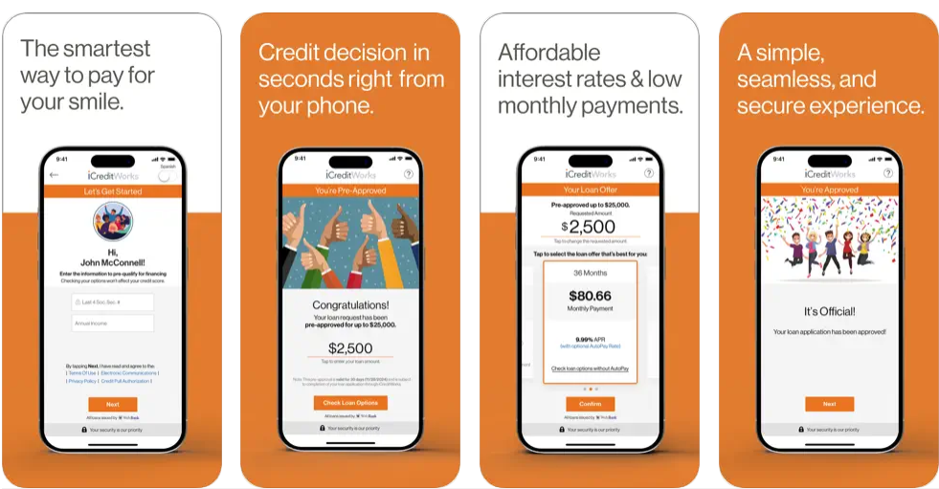
Case study - iCreditWorks
Background
Challenges
Solution
Processed documents.
Notes:
Slide 7 – 5 Minutes
Case study - iCreditWorks
Background: iCreditWorks aims to modernize and streamline the lending process at the point where sales occur, making it more efficient and customer-friendly. Currently, iCreditWorks caters to dental financing and expanding to other industry verticals.
Challenge: The third-party e-signing service they relied on charged a fee of $0.70 for each digital signature. Considering their estimated 100,000 funded loans annually, this translated to a substantial expense of $70,000. Additionally, the external vendor’s platform limited their customization options, preventing iCreditWorks from achieving a consistent brand look and feel across their digital platforms.
Solution: Recognizing the dual challenges of cost and branding, iCreditWorks took the step to develop an in-house e-signing microservice. By transitioning to an in-house solution, iCreditWorks achieved cost savings, enhanced branding, and operational efficiency.
Documents processed: iCreditWorks has successfully processed a large number of agreement documents. This volume encompasses a diverse range of documents, from customer agreements pertaining to loan applications to intricate network provider agreements. This showcases the reliability of the in-house e-signing service, and it also highlights the capability to adeptly manage a variety of document types.
Transitioning to in-house solutions isn’t just about cost-saving. It’s about gaining control and flexibility and ensuring that the user experience aligns with the brand’s vision.

Slide 8
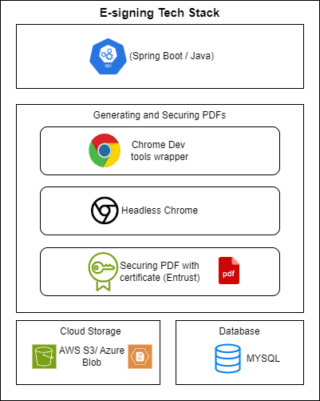
Building an in-house E-Signing microservice – Tech Stack
Spring Boot with Java
Generating and Securing PDFs
Cloud Storage (AWS S3 or Azure Blob)
Database (MySQL).
Notes:
Slide 8 – 5 Minutes
When building any microservice, especially with critical business functionalities, it’s essential to choose a tech stack that’s robust, scalable, and has wider community support. The e-signing microservice is built on the following technology stack:
Spring Boot
This is a standard REST API interface developed in Java using the Spring Boot framework. Spring Boot provides rapid development capabilities and wider community support. There are two main APIs: one to fetch the initial document for signing and another to post the signature, which then returns the signed document.
Generating and securing PDFs
To generate PDF documents, we use headless Chrome. In Java, there’s a Maven package that serves as a wrapper for the Chrome dev tools, named chrome-devtools-java-client. To secure the PDFs, we employ an external third-party certificate. For iCreditWorks, the certificate is sourced from Entrust.
Cloud storage
It’s essential to store generated documents, user signatures, and published templates for documents that need signatures. All of these are stored in the cloud. If AWS is the cloud provider, AWS S3 is used. Alternatively, for Azure, Azure Blob storage is the choice. Additionally, Google Cloud Platform (GCP) also offers robust storage solutions like Cloud Storage, which could be integrated as per the organization’s needs.
Database
The database is mainly for state storage between the APIs. It also stores document-related artifacts and the payload sent with the initial request. The current GitHub implementation uses MySQL as the database, but it can be replaced with any other relational database like MS SQL Server, Postgres, or Oracle. We can use NoSQL databases like MongoDB as well.

Slide 9
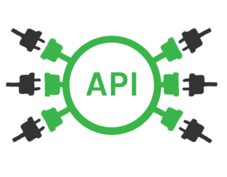
Building an in-house E-Signing microservice – APIs
Generate documents for signing
Post-signature and get a signed document
Notes:
Slide 9 – 2 Minutes
There are primarily two endpoints, which ensure a straightforward process for the user, from document generation to signing.
Generate documents for signing
Post-signature and get a signed document
We will delve into the above two steps in detail below, and we will start first with generating documents. Generating documents is the initial step in the e-signing process, where business-specific legal documents are created using predefined templates and dynamic data. This section will detail the process, from fetching and populating templates to converting them into ready-to-sign PDF documents.

Slide 10
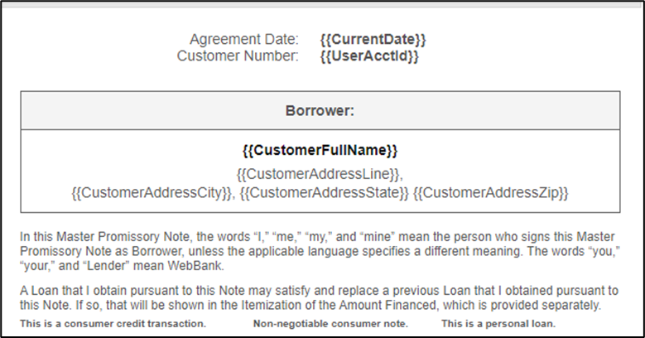
Building E-Signing microservice – Generate Document - 1
Templates
Multiple templates to carter to different document types.
Templated variables {{CustomerAddressCity}}, {{CustomerAddressState}}, {{CustomerAddressZip}}).
API Details
POST {{baseUrl}}/api/e-sign/v1/document/{contentType}
Request Body
{
"docCode": "GEN-MPN-01",
"contextId": "LN-1000109-01",
"localePreference": "en-US",
"fields": {
"CurrentDate": "09/03/2023",
"UserAcctId": "LN-1000109-01",
"CustomerFullName": "John Doe",
"CustomerAddressLine": "1100 Fox Run Dr",
"CustomerAddressCity": "Iselin",
"CustomerAddressState": "NJ",
"CustomerAddressZip": "08050"
}
}
Notes:
Slide 10 – 5 Minutes
The e-sign service uses templates to create business-specific legal documents for signing. At iCreditWorks, there’s a specific process to publish a template. The assumption here is that the template has already been published and is stored on cloud storage. These templates are HTML files with static content and templated variables (e.g., {{CustomerAddressCity}}, {{CustomerAddressState}}, {{CustomerAddressZip}}). These tokenized variables are replaced with actual values at runtime.
Implementing tokenized variables within templates facilitates dynamic content creation, catering to diverse business needs. Additionally, it provides versatility by supporting various document types through distinct templates.

Slide 11
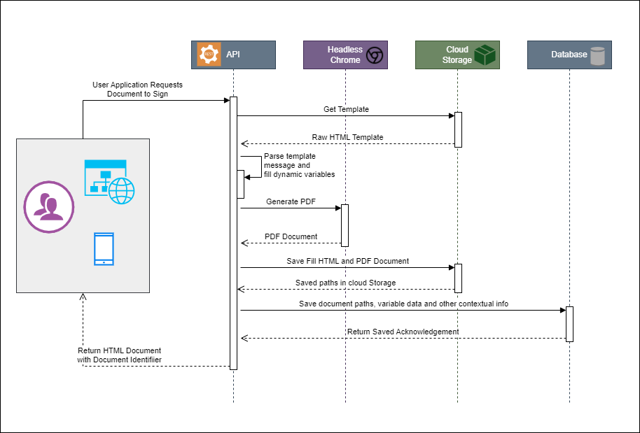
Building E-Signing microservice – Generate Document - 1
Fetch the template and prepare final content
Convert the HTML file into a PDF document.
Save Document and metadata
Return HTML Response with unique Identifier
Notes:
Slide 11 – 5 Minutes
In this segment of our presentation, we will walk through the technical workflow that brings digital signing to life at iCreditWorks. This process is a combination of cloud storage, dynamic data processing, and the transformative capabilities of headless browsers. Let’s break it down step-by-step:
Template Retrieval: It all starts when we fetch the specified document template from cloud storage. This is done using a unique template code that tells our system exactly what framework to build upon.
Dynamic Data Population: With the template in hand, our service now dynamically populates it. This involves replacing predefined variable tokens within the HTML with actual values provided in real-time. Think of it as a mail merge on steroids, but for web documents.
Conversion to PDF: Once we have a fully populated HTML document, it’s time for the transformation. We employ a headless Chrome instance—essentially, a browser without a graphical user interface—to accurately convert the HTML into a PDF document. This step is crucial for ensuring the document is in a widely accepted and secure format for signing.
Storage and State Management: Both the newly generated HTML and the PDF document are then stored securely in cloud storage. Simultaneously, we record the document metadata and other pertinent data in our database. This maintains the state for the document request and ensures we can track and manage the document through its lifecycle.
API Response: Our API is designed to be flexible. It typically returns an HTML response, enabling immediate viewing and interaction. However, it can also return a PDF if that’s what’s needed. Additionally, every document is assigned a universal unique identifier, or UUID, which is returned in the API response header. This UUID is essential for any subsequent API interactions with the document.
This end-to-end process exemplifies the seamless integration of modern web technologies to create a robust e-signing solution that is both efficient and secure.

Slide 12
Building E-Signing microservice – Post-signature and get signed document -2
POST {{baseUrl}}/api/e-sign/v1/document/signature/{{eSignDocumentUUID}}/html
Request Body (form- Data):
Key: "signature"
Value: "User’s signed image"
Notes:
Slide 12 – 2 Minutes

Slide 13
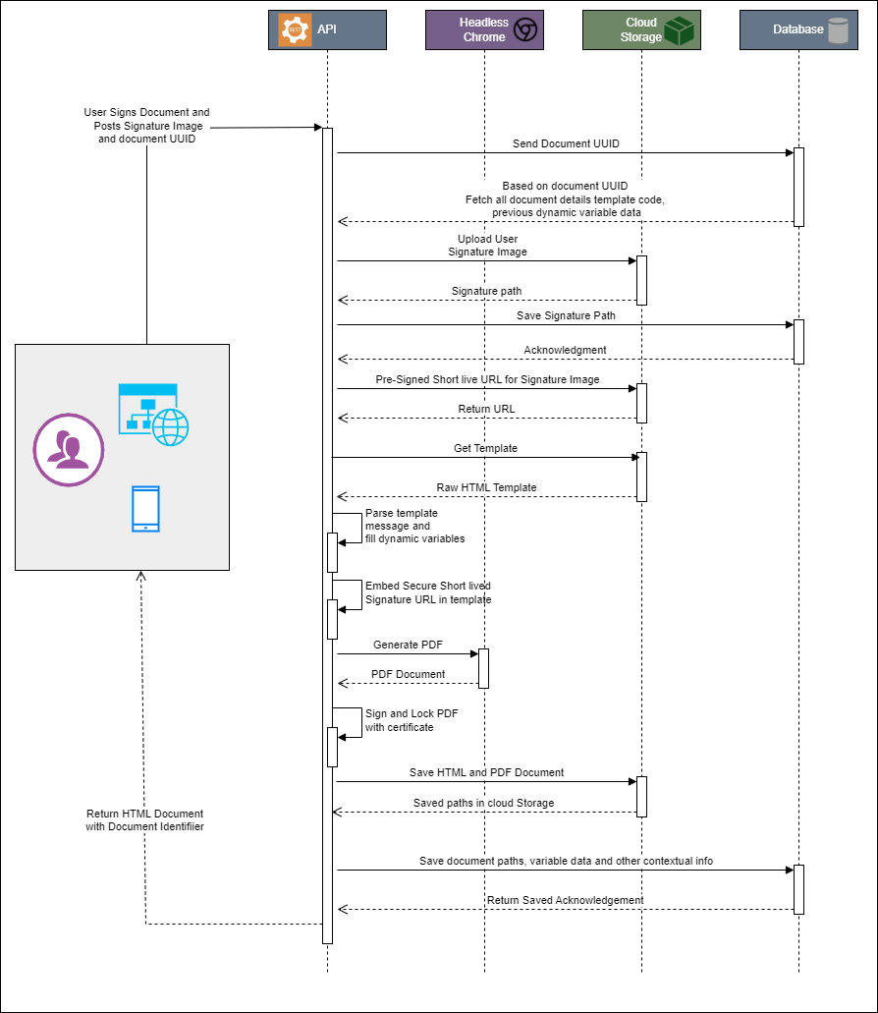
Building E-Signing microservice – Post-signature and get signed document -2
Document UUID
User’s signature image
Regenerate Template with dynamic data.
Pre-Signed URL
https://{{s3bucketname}}.s3.amazonaws.com/e-sign/LN-1000109/LN-1000109-01/CustomerSignature/2023-10-02T00-25-43-806.customer_signature.jpeg?X-Amz-Algorithm=AWS4-HMAC-SHA256&X-Amz-Date=20231002T002545Z&X-Amz-SignedHeaders=host&X-Amz-Expires=86398&X-Amz-Credential=AKIA46UPUH6Y5RO%2F20231002%2Fus-east-1%2Fs3%2Faws4_request&X-Amz-ignature=a4b3404bba99ac81b39afd31427031adbe9e
Notes:
Slide 13 – 3 Minutes
In this phase of our e-signing microservice, we’re looking at what happens after the initial document generation — when the user is ready to sign. Let’s examine the steps involved:
Document State Retrieval: The API request arrives with a document UUID, which serves as a key, unlocking the previously saved state from our database. This state is crucial as it encapsulates all the information we’ve gathered in the previous steps, allowing us to maintain a coherent and continuous signing process.
Signature Upload and Storage: As the user finalizes their signature, that image is encoded within the request body. Upon receipt, our service uploads this image to a secure location in the cloud. The storage path is then logged in our database, linking the signature to its document.
Data and Template Assembly: With the signature safely stored, we retrieve a fresh template — a clean slate ready to be filled. We then start a process, where tokenized placeholders in the template are replaced with dynamic data drawn from our state information.
Signature Integration: A pre-signed public URL to the signature image is generated, which offers time-limited access to the resource, ensuring security and privacy. This URL is then seamlessly integrated into the template, positioning the signature exactly where it needs to be.
These steps culminate in a document that is not just a series of pages but a personalized agreement, ready for review and final acceptance.

Slide 14
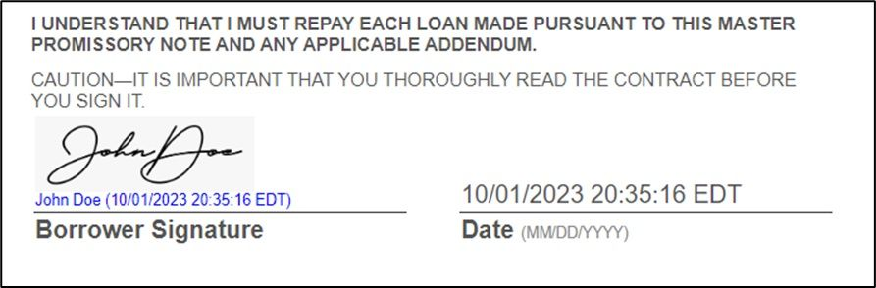
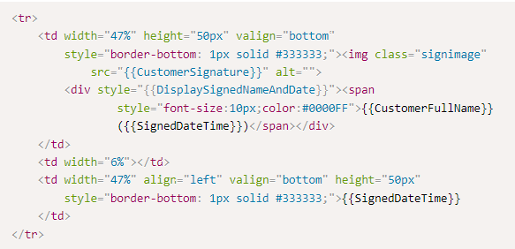
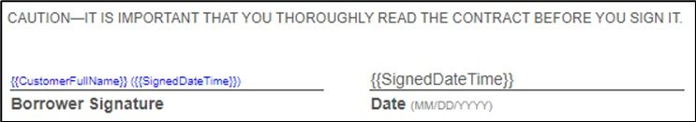
Building E-Signing microservice – Post-signature and get signed document -2
Customer Signature
Limited time token
{{baseUrl}}/v1/document/157f55tt-e8d1-4f6e-90bb-dc5341bc4fa4?token=78902bed-60c2-11ee-acd2-0aa24276fac5
Save Document and metadata
Return Signed Document HTML Response
Notes:
Slide 14 – 4 Minutes
Here is the sample of one of the templates where the user’s signature will be inserted. Point to one of the images on the slide.
{{CustomerSignature}} – This variable in the image is replaced with the Pre-Signed URL.
Onetime token - At iCreditWorks, we use the concept of a one-time token instead of a Pre-signed URL; a one-time token is appended to the URL, along with the UUID, which is associated with the signature image that has been stored in the cloud storage (AWS S3). The token in the URL can be used only once and will be short-lived.
After digitally signing the PDF document, both the HTML and PDF versions of the signed document are saved in cloud storage. The paths from the cloud storage are then saved in the database.
Once all the steps are completed, the signed HTML document response is sent to the consuming application, allowing the user to view the signed document.

Slide 15




Security measures in E-Signing
E-signing Certificate
Storage Security
Handshake Protocol
Notes:
Slide 15 – 5 Minutes
Having explored the detailed steps of the e-signing process, let’s shift our focus toward the security measures that ensure the integrity and confidentiality of the signed documents in the e-signing service.
Security measures in e-signing
E-signing Certificate: The e-signing service uses a digital certificate to authenticate the identity of the signer and to provide the signer with a unique digital ID. This certificate is issued by a trusted third-party Certificate Authority (CA) and ensures the integrity and authenticity of the signed document.
Integrity: The digital signature process involves creating a hash (a unique digital fingerprint) of the document's contents. When the document is signed, this hash is encrypted with the signer's private key. Anyone with access to the public key (which is available through the certificate) can decrypt the hash and compare it with the document's current hash. If they match, it means the document has not been altered since it was signed, ensuring its integrity.
Storage Security: All signed documents and associated data are encrypted in a secure cloud storage.
Handshake Protocol: The e-sign service uses a secure handshake protocol to establish a secure connection between the client and the server. This ensures that the transmitted data is encrypted and secure from any potential eavesdropping or tampering.
When you sign a document online with your e-signing certificate:
It's like sealing an envelope with a wax seal that has your unique mark. This proves that the envelope hasn't been opened or tampered with since you sealed it.
It's also like sending a letter with a return receipt request. Just as the receipt proves you sent the letter, the e-signing certificate proves you signed the document.
If someone tries to copy your wax seal on another envelope (or document), it won't match perfectly. Similarly, if someone tries to change the document after you've signed it, the digital "seal" won't match, and the recipient will know it's been tampered with.

Slide 16

Open-Source Availability
E-signing microservice’s codebase is available on GitHub.
https://github.com/iCreateWorks/esigning
Aim is to benefit
FinTech Start Ups
Other Star Ups
Notes:
Slide 16 – 3 Minutes
By sharing the solution with the broader community, we aim to empower other startups and FinTechs to benefit from our development efforts and to foster a collaborative environment for continuous improvement.
The potential of in-house e-signing solutions isn’t limited to fintech. Various other industries can leverage the open-source solution.

Slide 17

Conclusion and Q&A
Notes:
Slide 17 – 2 Minutes
In today’s digital-centric world, businesses must continuously seek ways to enhance operational efficiency, reduce costs, and provide a seamless user experience.
The transition to an in-house e-signing solution, as illustrated in our case study, not only led to significant cost savings but also provided the flexibility to tailor services to unique branding and operational needs.
While third-party solutions offer convenience, there’s undeniable value in building proprietary systems that align closely with a company’s vision.
As industries continue to digitize, the ability to adapt, innovate, and customize becomes paramount.
Investing in in-house solutions can be a strategic move toward achieving that agility and laying the groundwork for sustained growth in the digital era.

Slide 18

Be in touch
Amol Gote
https://www.linkedin.com/in/aamolgote
www.amolgote.com
https://dzone.com/users/4953252/aamolgote.html
https://www.baeldung.com/author/aamolgote

